Slide 1
Advanced Object Oriented Programing
Online House rental web portal
2110030190 - K. Sai Vardhan Reddy 2110030109 - D. Harshavardhan Reddy
2110030252 - Mohammed Afeef Sayeed

Slide 2
Introduction
To develop a house rental management system that allows the user to view customers' data as well as houses record
To study currently available online house rental system in the market in our country

Slide 3
About
Now a days city life is dependent largely on technology. Real estate or property sector is also using latest technologies.
So it is a highly potential sector in Bangladesh specially in urban areas. Also as a student ourselves, we have to stay far away from our home for study purpose and we need houses on rent for accommodation.
We had the first hand experience of how difficult it is to find a proper place for accommodation.

Slide 4
FUNCTIONAL REQUIREMENTS
Allow administrator to add a houses, tenant and defaulters details
Allow the administrator to delete houses, tenants and defaulters details
Allow the administrator to search data in the database
Allow the administrator to edit data in the database

Slide 5
Data Set Collections
User{Name,Contact_Number,Email}
Admin{ID,Name,Username,Password}
House{Area,Type,Address,Price,Owner_Name}

Slide 6
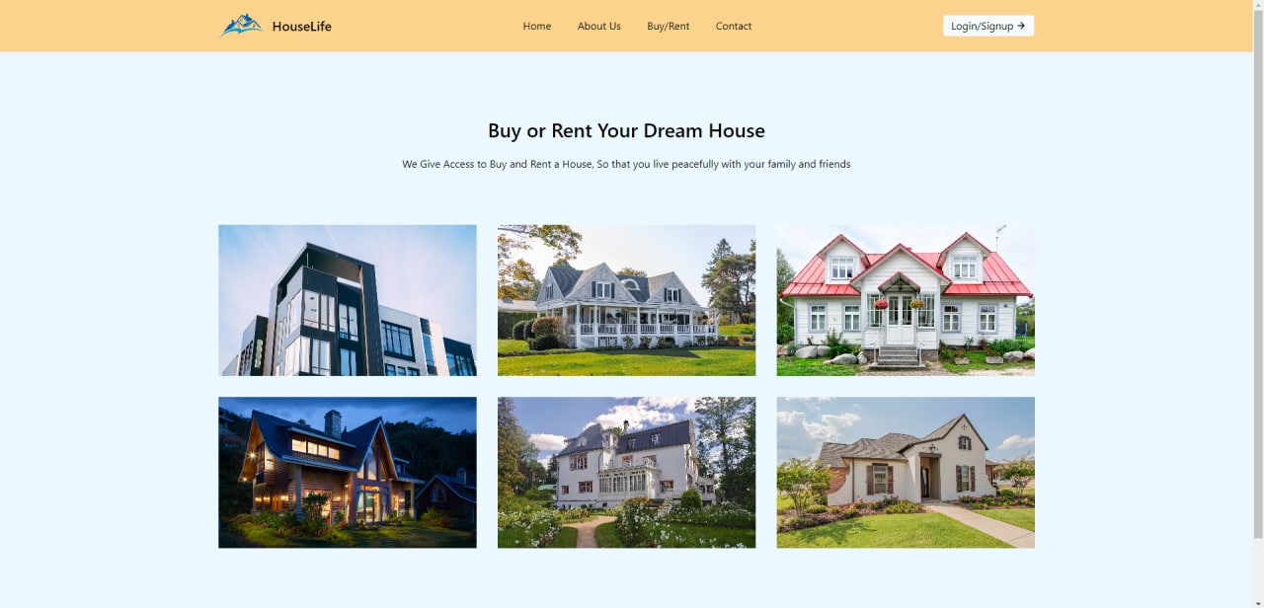
Work In Progress
Home Page

Slide 7
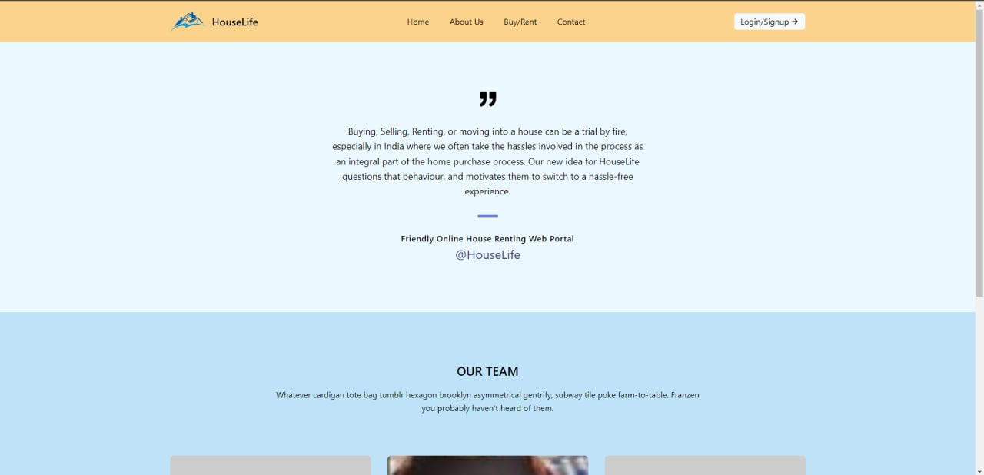
About Page

Slide 8
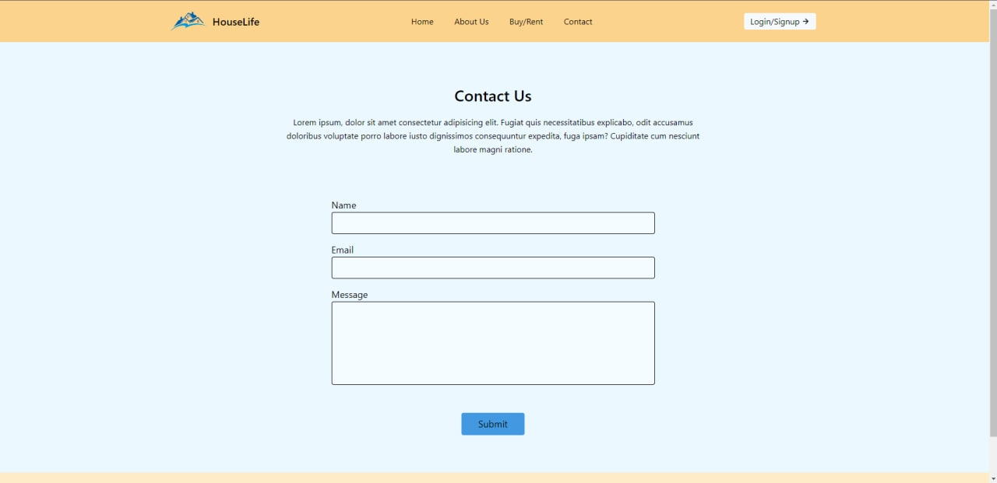
Contact Page

Slide 9
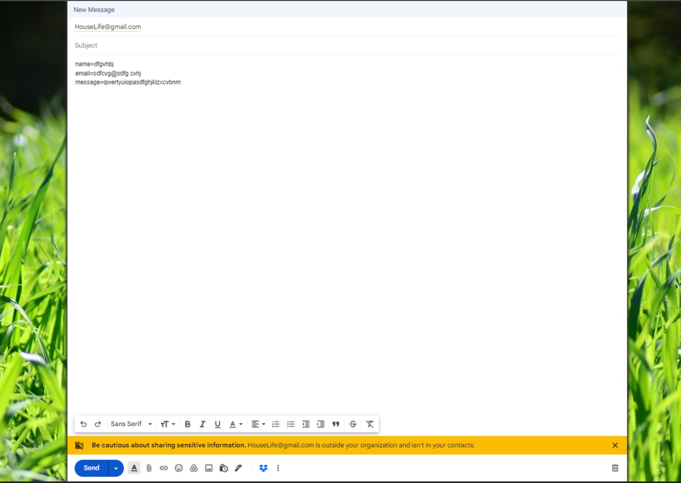
Feed back Form In Email

Slide 10
Tools Setup
JAVA
HTML
JAVA SCRIPT
CSS
MYSQL

Slide 11
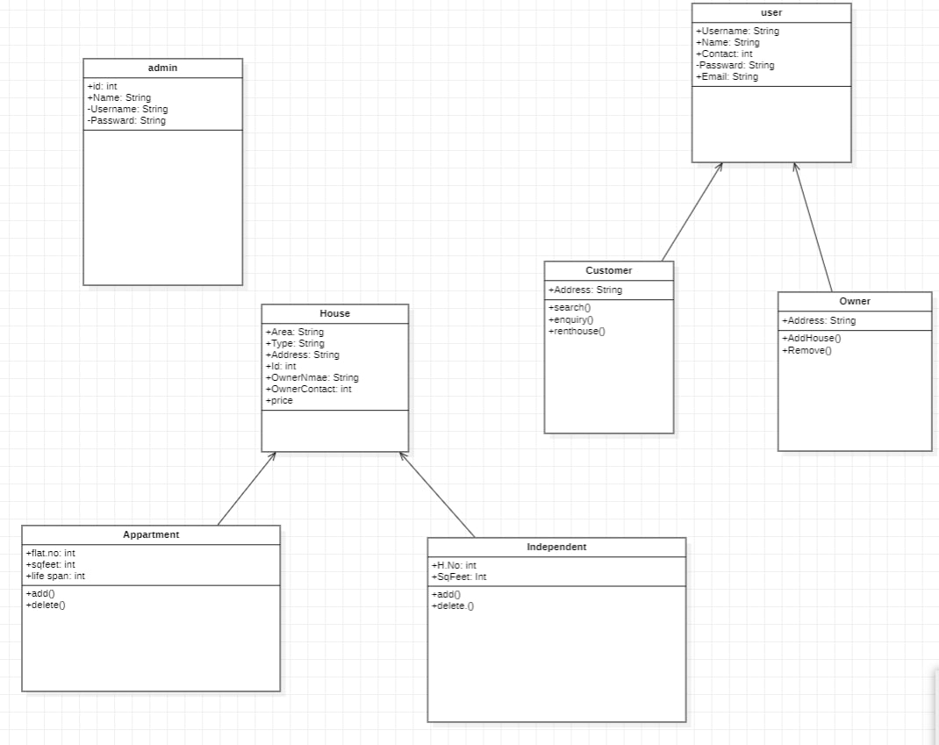
Class Diagram

Slide 12
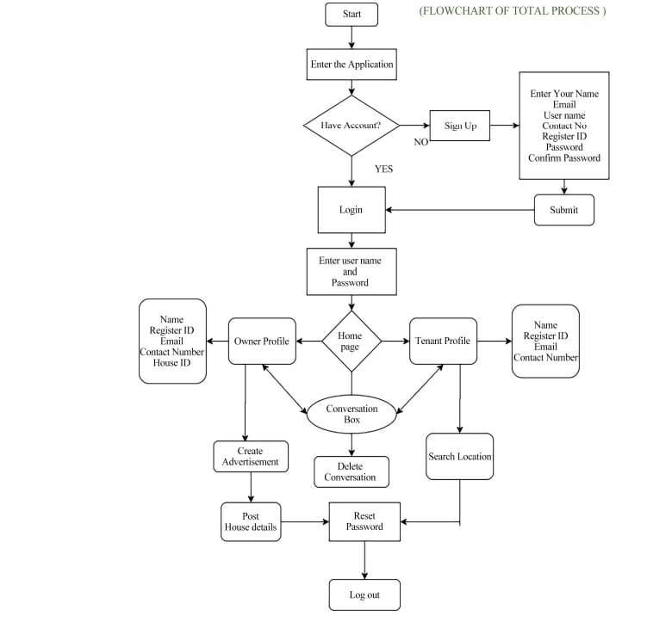
Flow Chart

Slide 13
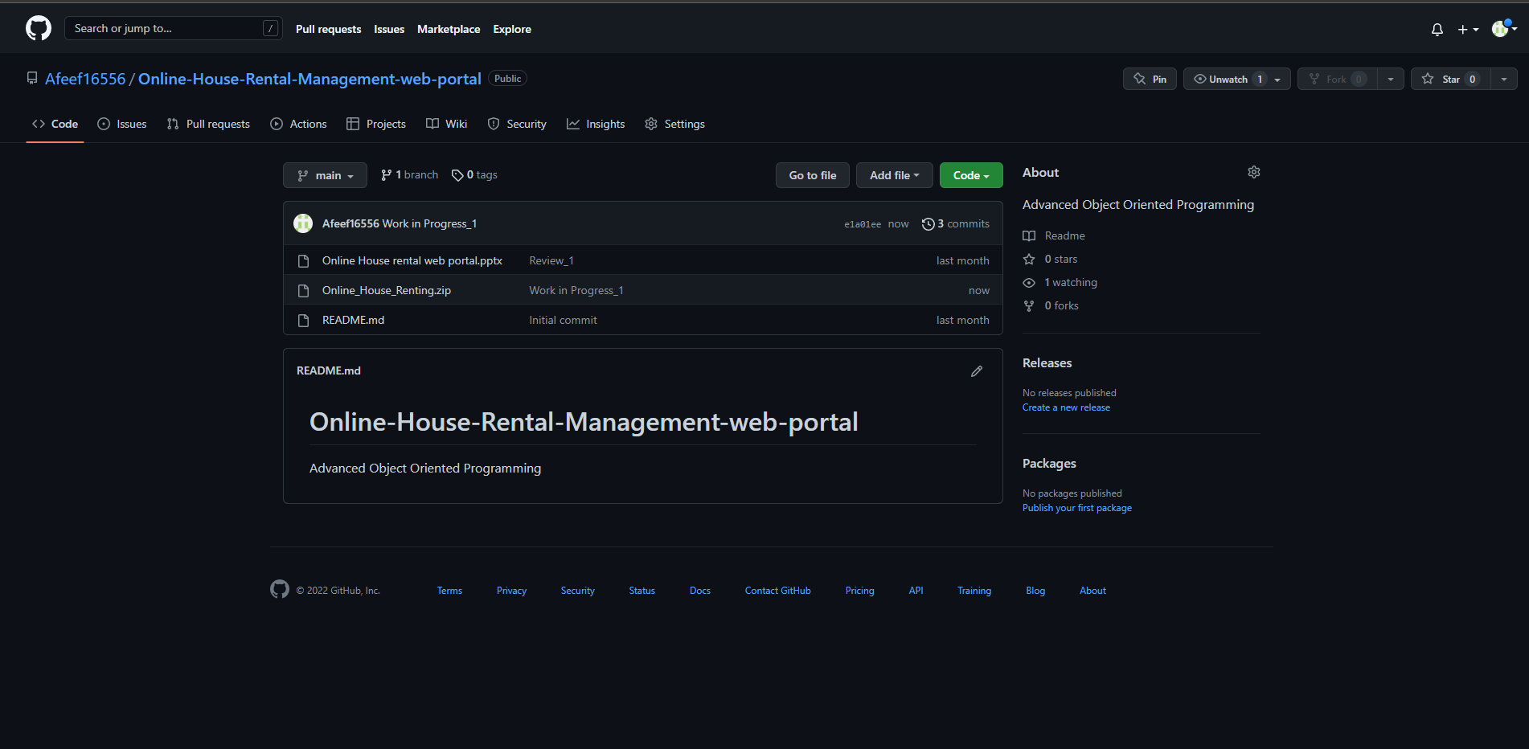
GitHub Setup
https://github.com/Afeef16556/Online-House-Rental-Management-web-portal/settings

Slide 14
Conclusion
Online house rental business has emerged with a new possibilities compared to the past experience where every activity concerning house rental business was limited to a physical location only.
Even though the physical search for houses has not been totally eradicated; the nature of functions and how these functions are achieved has been reshaped by the power of internet.
Nowadays, renters can reserve houses online once the customer is a registered member of the website.

Slide 15
Thank You

